Slide 1
MediCaring: Reliable Care at Sustainable Cost for the Years We Live with Frailty
Joanne Lynn, MD, MA, MS, Director, Center for Elder Care and Advanced Illness
November 12, 2013
Joanne.Lynn@altarum.org

Slide 2
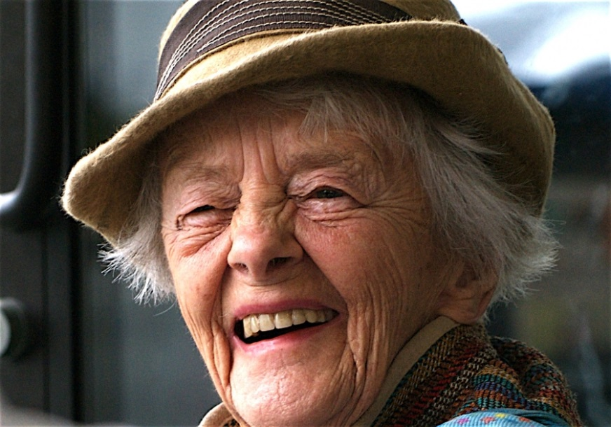
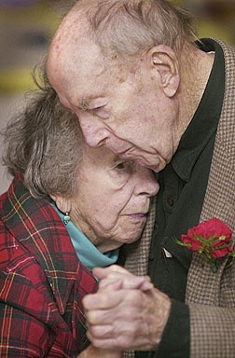
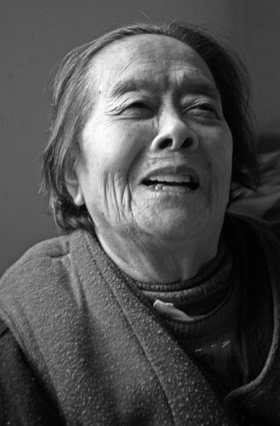
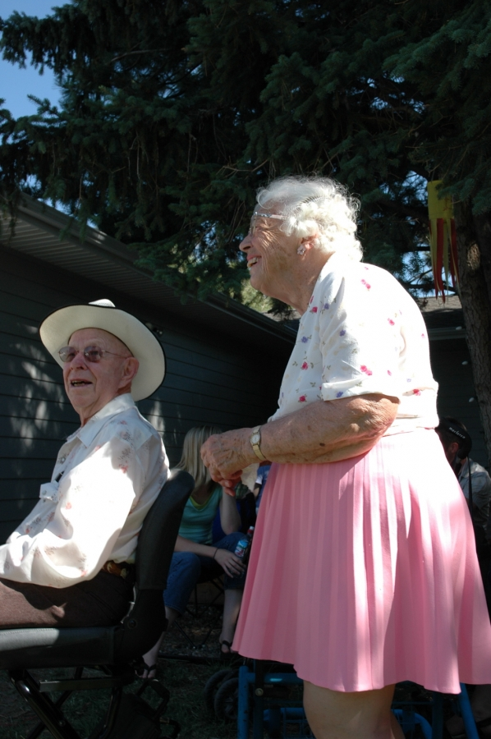
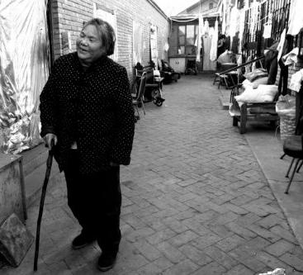
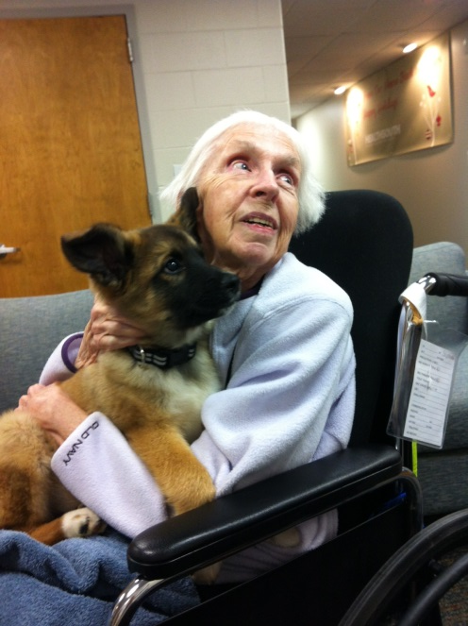
The various appearances of frailty
Photo credits: http://creativecommons.org/licenses/by/2.5/

Slide 3
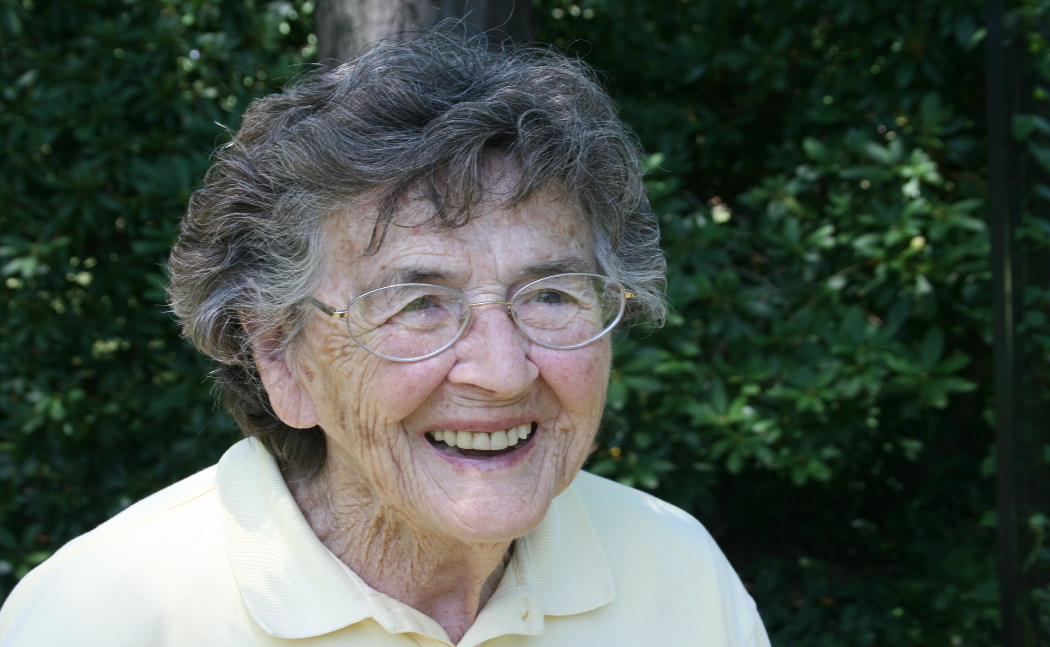
My Mother’s Broken Back

Slide 4
The Cost of a Collapsed Vertebra in Medicare

Slide 5
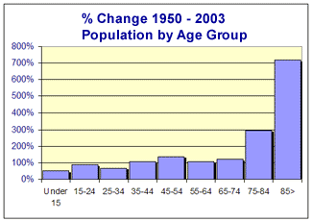

Slide 6
U.S. consumption by age (private + public transfers)
Y axis: 1 = Average Labor Income Ages 30-49
1960
1981
2007
Source: U.S. National Transfer Accounts, Lee and Donehower, 2011.
Also in Aging and the Macroeconomy, National Academy of Sciences, 2013

Slide 7
You take care of Mom, but who will take care of you?
Policy Action
Rising Demand
+
Shrinking Families to provide LTSS
Call for new solutions to the financing & delivery of LTSS & families
Source: D. Redfoot, L. Feinberg, and A. Houser, THe Aging of the Baby Boom and the Growing Care Gap: A look at Future Declines in the Availability of Family Caregivers (Washington, D.C.: AARP Public Policy Institute, August 2013). www.aarp.org/research/ppi

Slide 8
How are we going to avoid big trouble?

Slide 9
MediCaring!
Aim?
Assure that Americans can live comfortably and meaningfully at a sustainable cost through the period of frailty that affects most of us in our last years

Slide 10
MediCaring! Key Components of Reform
Customize services for frail elderly cohort
Generate good patient-centered care plans
Adapt medical care
Include long-term services
Develop local layer of monitoring and management
Channel the fear and frustration into the will to change

Slide 11
Identification of Frail Elders in Need of Medicaring™
AND one of the following:
>1 ADL deficit or
Requires constant supervision OR
Expected to meet criteria in 1-2Y
Unless Opt Out
Age >65
Frail Elderly
Age >85
Want a sensible care system
With Opt In

Slide 12
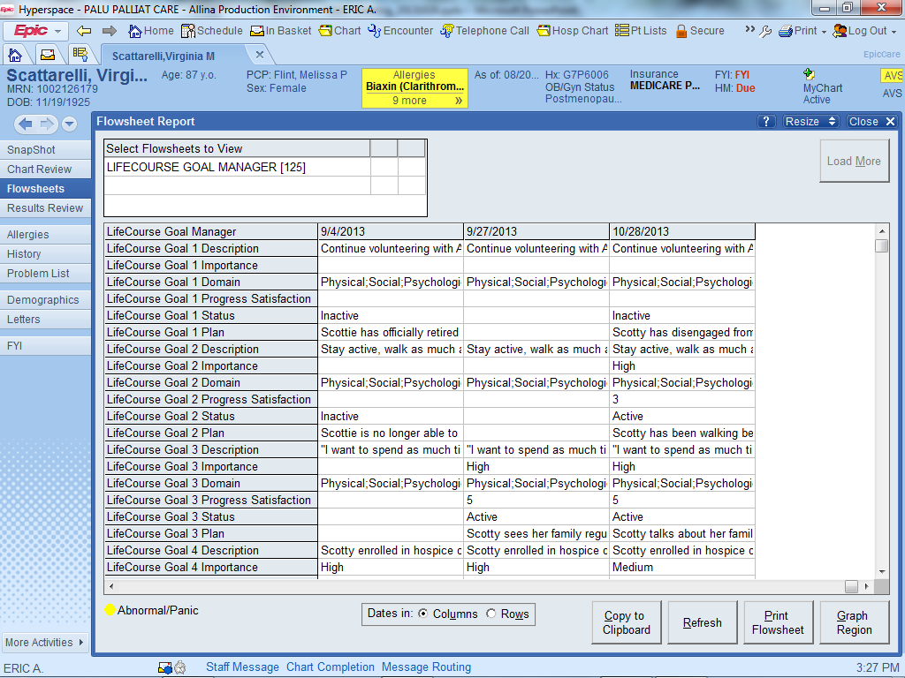

Slide 13
About Customized Service Plans
Articulated
Values
Plan
Goals
Implement
Integration
Outcomes
Feedback
Feedback
Evaluation of Quality

Slide 14
Patient- Reported Pursuit of Goals Uneven interval, multiple reporting strategies
Date | Score | Ideal Score
7/1/2012 | 2 | 4
8/3/2012 | 4 | 4
8/8/2012 | 3 | 4
10/12/2012 | 1 | 4
2/28/2013 | 4 | 4
3/2/2013 | 3 | 4
5/23/2013 | 0 | 4
6/1/2013 | 3 | 4
6/30/2013 | 4 | 4

Slide 15
Geriatricize Medical Care
Continuity
Reliability, 24/7 to the end of life
Enabling self-management around disabilities
Respecting and including family and other caregivers
Attend to the burden of medical care
Move services to the home
Prevent falls, avoid side-effects of treatment
Enhancing relationships, activities, meaningfulness
Enduring dementia

Slide 16
Health-service and social-services expenditures for OECD countries (%GDP - 2005)
BMJ Qual Saf 2011;20:826e831.

Slide 17
Health-service and social-services expenditures for OECD countries (as Ratio – 2005)
US level
BMJ Qual Saf 2011;20:826e831.

Slide 18
Disaster for the Frail Elderly: A Root Cause
Inappropriate
Unreliable
Unmanaged
Wasteful “care”
Social Services
Funded as safety net
Under-measured
Many programs, many gaps
No Integrator
Medical Services
Open-ended funding
Inappropriate “standard” goals
Dysfunctional quality measures

Slide 19
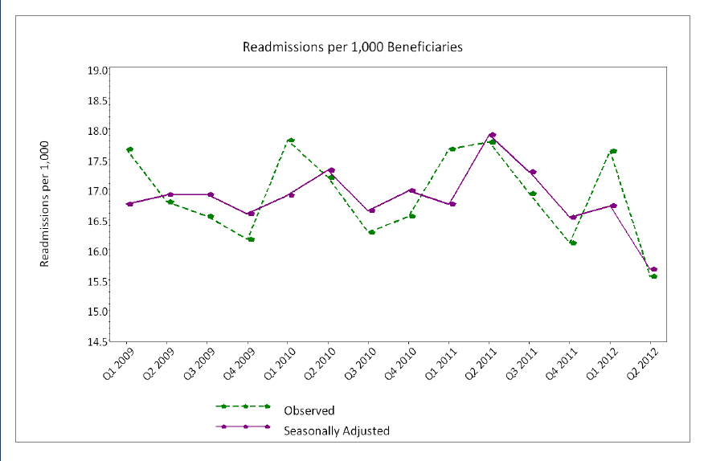
Cincinnati Area Readmissions Over Time

Slide 20
A Winning Option: Local MediCaring ACOs…
Four geographic communities - 15,000 frail elders as steady caseload
Conservative estimates of potential savings from published literature on better care models for frail elders
Yields $23 million ROI in first 3 years
Net Savings for CMS Beneficiaries |  | Yr 1 | Yr 2 | Yr 3 | 3-Yr
Before Deducting In-Kind Costs |  | -$2,449,889 | $10,245,353 | $19,567,328 | $27,362,791
After Deducting In-Kind Costs |  | -$3,478,025 | $8,463,101 | $17,629,209 | $22,614,284
For more on financial estimates, see http://medicaring.org/2013/08/20/medicaring4life/

Slide 21
The MediCaring Reforms
Frail Elders and their Families
Should Demand
Care plans
Caregiver support
Honest assessment of the future
Much more opportunity to stay at home
Get Angry. Complain effectively. Encourage effective complaining and advocacy!

Slide 22
The MediCaring Reforms
Community –
Standardize assessments and care plans
Develop entity to be accountable for frail elders
Build on existing coalitions, professional organizations, public trust (including Community-Based Care Transitions)
Encourage rapidly escalating reforms
Build IT and quality measurement -- and establish the community trust entity that can manage geographic special purpose ACOs

Slide 23
The MediCaring Reforms
State and Federal governments –
Allow the reforms to happen. Create a trial program that a dozen communities can try
Fund development of useful quality measures
Require care plans, standardize assessments
Advocate for reforms, funding, the will for reform! Talk with legislative representatives and executive agencies. Build constituencies.

Slide 24
What We Really, Really Need…
The Cohort – Frail elderly
The Care Plan – For each frail person, at all times
The Services – Adapted; in-home, supportive
The Scope – Social services equally important
Local Monitoring & Management
AND THE WILL TO MAKE THESE CHANGES!

Slide 25
We can have what we want and need When we are old and frail
But only if we
deliberately build that future!

Slide 26
MediCaring: Reliable Care at Sustainable Cost for the Years We Live with Frailty
Joanne Lynn, MD, MA, MS, Director, Center for Elder Care and Advanced Illness
November 12, 2013
Joanne.Lynn@altarum.org

